Slide 1
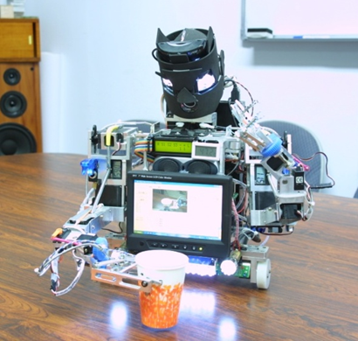
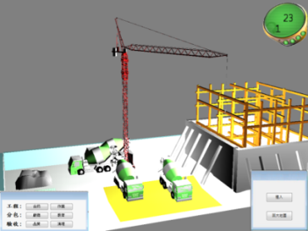
5-year Program for BS & MS
College of Engineering
目 的
Background
Fast track for distinguished students to complete BS and MS in 5 years
Requirement
Requirements are set by each department
(Minimum of one-semester Special Projects)
Application time
Jan 3 - Mar 14, 2023
Result announcement
Results will be announced on the website of College of Engineering and each Department on March 31, 2023
Qualification
Third-year students
Detail
Please refer to the website of College of Engineering
and each Department

